Slide 1
APPROXIMATION ALGORITHMS
Need for Approximation Algorithms
Bin Backing
Travelling Salesman Problem
Max-SAT
Vertex Cover Problem

Slide 2
Approximation Algorithms
How do we deal with problems where we don't have an efficient algorithm for solving the problem?
One option: Use of heuristics
But we'd like some guarantee: The answer we get should never be too far from the optimal.
The answer is Approximation Algorithms.

Slide 3
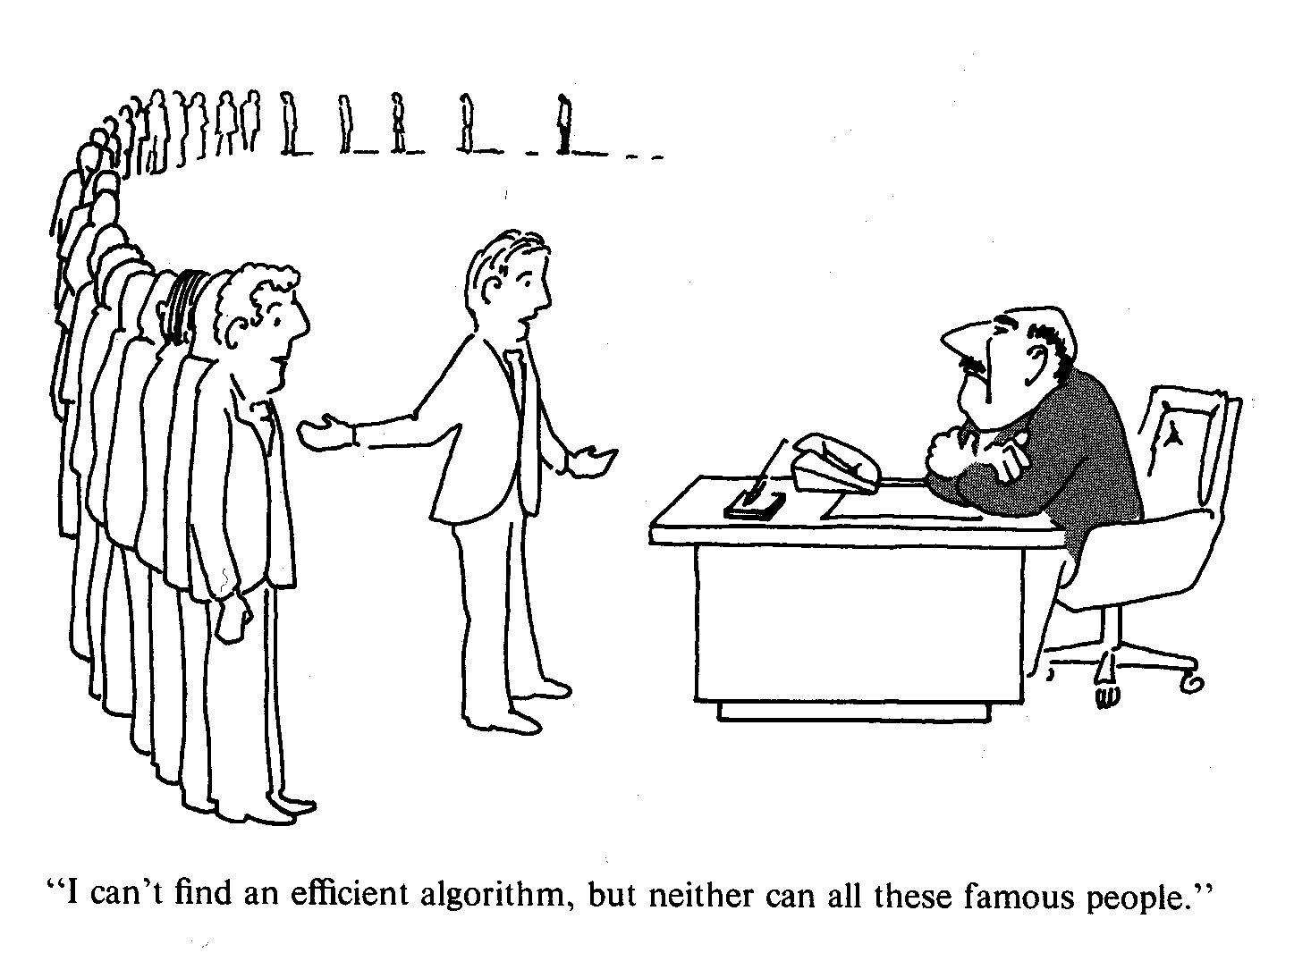
NP-completeness
!
Do your best then.

Slide 4
Need for Approximation algorithms
Optimal algorithms are too slow.
Heuristic algorithm are too uncertain.
The condition to provide result with guarantee is :

Slide 5
NP-completeness
NP is the class of decision problems in which we can get the answer to a problem in polynomial time.
A problem A is NP-complete if
- A is in NP
- Every B in NP has a polynomial time reduction to A.
(The second part is the definition of NP-hard)

Slide 6
Approximation algorithms
An Approximate Algorithm is a way of approaching the NP-COMPLETENESS in the optimization problem.
This technique does not guarantee the best solution.
The goal of an approximation algorithm is to come as close as possible to the optimum value in a reasonable amount of time which is at the most polynomial time.

Slide 7
Coping With NP-Hardness
Brute-force algorithms.
Develop clever enumeration strategies.
Guaranteed to find optimal solution.
No guarantees on running time.
Heuristics.
Develop intuitive algorithms.
Guaranteed to run in polynomial time.
No guarantees on quality of solution.
Approximation algorithms.
Guaranteed to run in polynomial time.
Guaranteed to find "high quality" solution, say within 1% of optimum.
Obstacle: need to prove a solution’s value is close to optimum,
without even knowing what optimum value is!

Slide 8
Standard Approach to Coping with NP-Hardness:
Approximation Algorithms
Run quickly (polynomial-time for theory, low-order polynomial time for practice)
Obtain solutions that are guaranteed to be close to optimal

Slide 9
Examples of Approximate Algorithms
Bin Backing
Travelling Salesman problem
Vertex cover
Knapsack problem
Planar Graph colouring

Slide 10
Bin Packing Problem Definition
Given n items with sizes s₁, s₂, ..., s_{n} such that 0 ≤ s_{i} ≤ 1 for 1 ≤ i ≤ n, pack them into the fewest number of unit capacity bins.
Problem is NP-hard (NP-Complete for the decision version).
There is no known polynomial time algorithm for its solution, and it is conjectured that none exists.

Slide 11

Bin Packing Example
The bins; (capacity 1)
1
……
.5 .7 .5 .2 .4 .2 .5 .1 .6
.5
.7
.5
.2
.4
.2
.5
.1
.6
Items to be packed

Slide 12
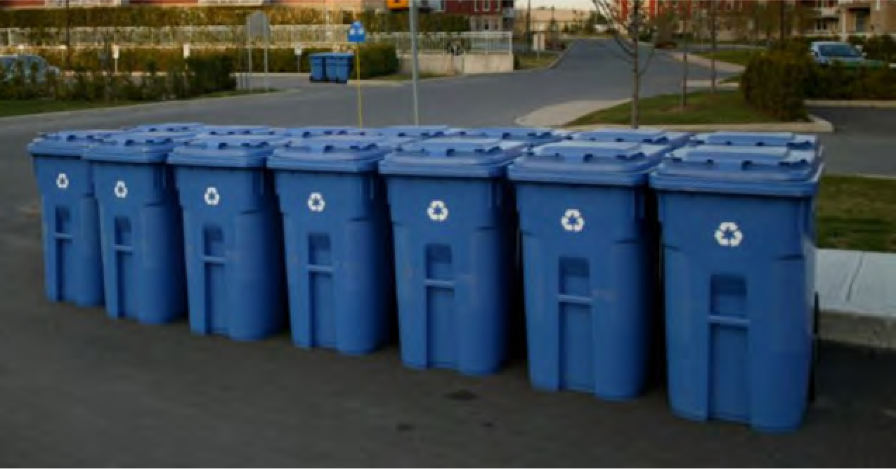
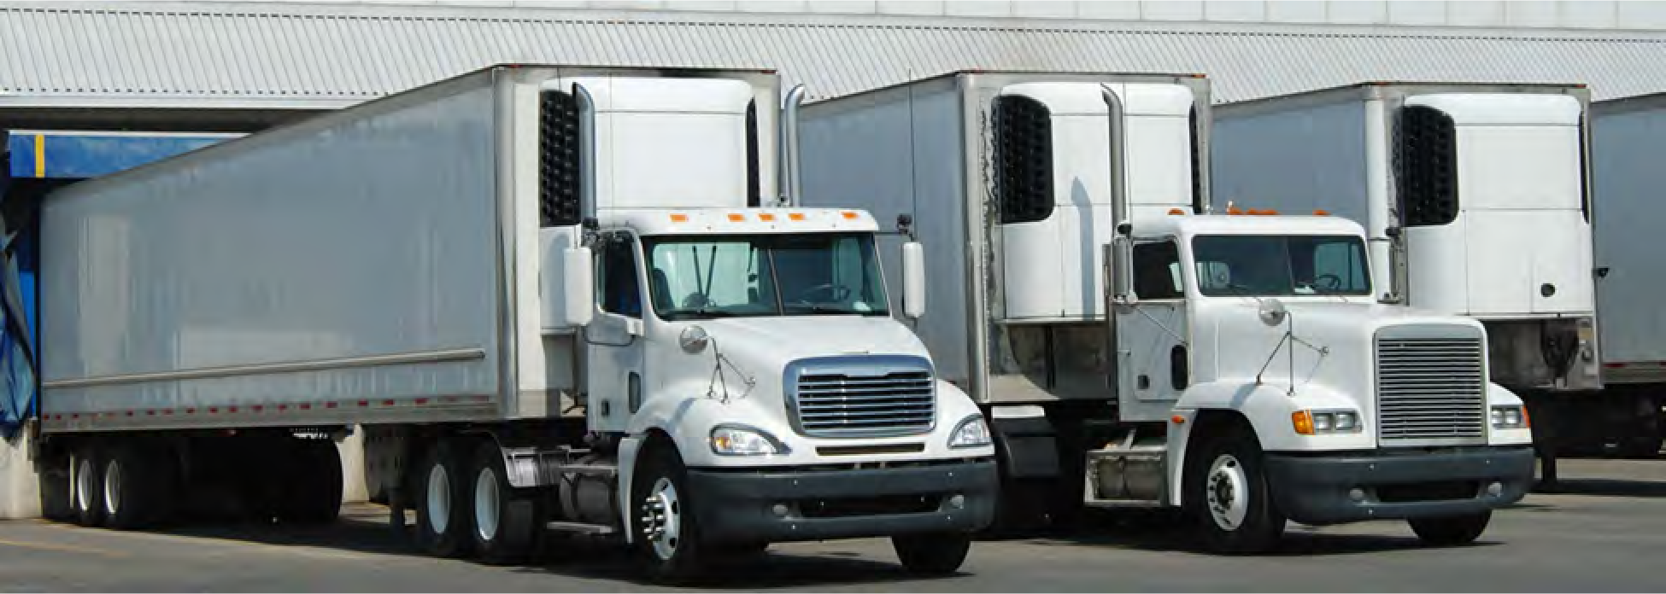
Example Applications
Filling recycle bins
Loading trucks

Slide 13
Bin Packing Optimal Solution
Bin Packing Problem
1
……
.5 .7 .5 .2 .4 .2 .5 .1 .6
Optimal Packing
.5
.2
.1
.5
.4
.6
.2
M_{Opt} = 4
.5
.7

Slide 14
Next-Fit (NF) Algorithm
Check to see if the current item fits in the current bin. If so, then place it there, otherwise start a new bin.

Slide 15
Next Fit (NF) Packing Algorithm Example
Bin Packing Problem
.5 .7 .5 .2 .4 .2 .5 .1 .6
.5
.2
.1
.5
.4
.6
.2
M_{Opt} = 4
.5
.7
Next Fit Packing Algorithm
.2
.5
.2
.4
.1
.5
.5
.7
.6
M = 6

Slide 16
First Fit (FF) Algorithm
Scan the bins in order and place the new item in the first bin that is large enough to hold it.
A new bin is created only when an item does not fit in the previous bins.

Slide 17
First Fit (FF) Packing Algorithm Example
.5 .7 .5 .2 .4 .2 .5 .1 .6
Next Fit Packing Algorithm
.2
.5
.2
.4
.1
.5
.5
.7
.6
First Fit Packing Algorithm
.5
.1
.2
.7
.2
.4
.5
.5
.6
M = 5

Slide 18
Running Time for First Fit
Easily implemented in O(n²) time
Can be implemented in O(n log n) time:
Idea: Use a balanced search tree with height O(log n).
Each node has three values: index of bin, remaining capacity of bin, and best (largest) in all the bins represented by the subtree rooted at the node.
The ordering of the tree is by bin index.

Slide 19
Best Fit Algorithm (BF)
New item is placed in a bin where it fits the tightest. If it does not fit in any bin, then start a new bin.
Can be implemented in O(n log n) time, by using a balanced binary tree storing bins ordered by remaining capacity.

Slide 20
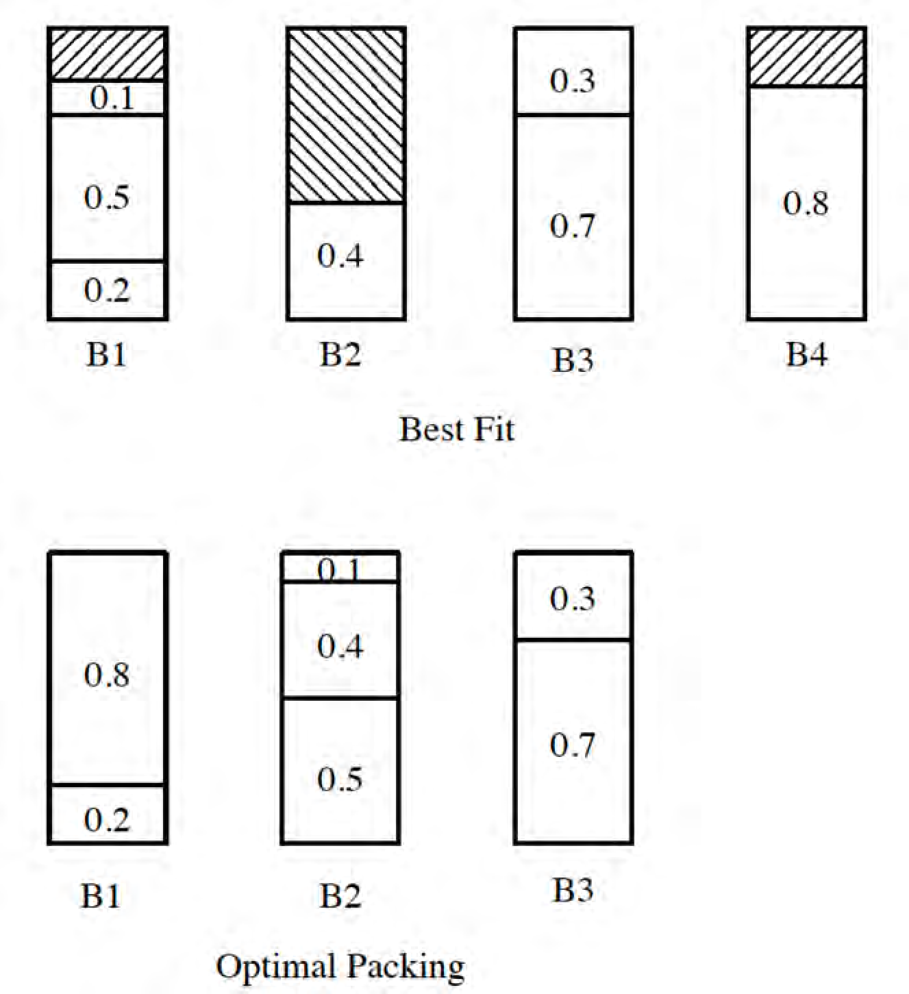
Example for Best Fit (BF)
I = (0.2, 0.5, 0.4, 0.7, 0.1, 0.3, 0.8)

Slide 21
Other Heuristics
First Fit Decreasing (FFD): First order the items by size, from largest to smallest, then run the First Fit Algorithm.
Best Fit Decreasing (BFD): First order the items by size, from largest to smallest, then run the Best Fit Algorithm.

Slide 22
Travelling Salesman Problem

Slide 23
Solution to TSP
Let A be the starting Vertex.
Vertex A is connected to nodes B,C and D.
The nearest neighbour is C, as the distance from vertex A to C is only 3, which is less than the distances from other vertices namely B and D.
Therefore, the selected path is AC.

Slide 24
Solution to TSP Contd…
From C, the nearest neighbour is B.
From B, the nearest neighbour is D, and finally one can return to the starting vertex A.
So the path is A-C-B-D-A, which has the cost of 24.
Similarly, the paths starting from other nodes such as B can be found.
Finally, the best solution can be obtained.

Slide 25
HC-Hamiltonian Cycle
Input: graph G=(V,E)
Output: A cycle tour in G that visits each vertex exactly once.
This problem is known to be NP-Hard.

Slide 26
TSP – Traveling Salesman Problem
Input: A complete graph G=(V,E) with edges of non-negative cost (c(e)).
Output: Finds a cycle tour of minimum cost that visits each vertex exactly once.
The problem is NP-Hard (reduction from HC) .
… and hard to approximate.

Slide 27
Vertex Cover
Vertex cover: a subset of vertices which “covers” every edge.
An edge is covered if one of its endpoint is chosen.
The Minimum Vertex Cover Problem:
Find a vertex cover with minimum number of vertices.

Slide 28
Approximation Algorithms
Key: Provably close to optimal.
Let OPT be the value of an optimal solution,
and let SOL be the value of the solution that our algorithm returned.
Constant factor approximation algorithms:
SOL <= cOPT for some constant c.

Slide 29
Vertex Cover: Greedy Algorithm 1
Idea: Keep finding a vertex which covers the maximum number of edges.
Greedy Algorithm 1:
Find a vertex v with maximum degree.
Add v to the solution and remove v and all its incident edges from the graph.
Repeat until all the edges are covered.
How good is this algorithm?

Slide 30
Vertex Cover: Greedy Algorithm 1
OPT = 6, all red vertices.
SOL = 11, if we are unlucky in breaking ties.
First we might choose all the green vertices.
Then we might choose all the blue vertices.
And then we might choose all the orange vertices.

Slide 31
Vertex Cover: Greedy Algorithm 1
Not a constant factor
approximation algorithm!
k! vertices of degree k
Generalizing
the example!
k!/k vertices of degree k
k!/(k-1) vertices of degree k-1
k! vertices of degree 1
OPT = k!, all top vertices.
SOL = k! (1/k + 1/(k-1) + 1/(k-2) + … + 1) ≈ k! log(k), all bottom vertices.

Slide 32
Vertex Cover: Greedy Algorithm 1
In m th iterations, algorithm removes at least half the edges of G
Thus
after m.log |G| iterations
all the edges of G have been removed
Algorithm 1 computes a vertex cover of size O(optimum. log n)
Greedy Algorithm 1 is an O(log n)
approximation algorithm

Slide 33
Vertex Cover: Algorithm 2
Greedy approach does not always lead to the best approximation algorithm
C = φ
while G has at least one edge
(u,v) of G do
G = G \ {u, v}
C = C ∪ {u or v}
return C
For edge (u, v), at least one of the vertices u or v must be in any of the optimal covers.
IT FOLLOWS IT IS A 2 APPROXIMATION ALGORITHM

Slide 34
Traveling Salesman
Traveling salesman problem
asks for the shortest Hamiltonian cycle in a weighted undirected graph.
Traveling salesman problem is NP hard

Slide 35
Traveling Salesman Problem
ASSUMPTION: All pairwise distances exist and they obey triangular inequality:
w(a,c) ≤ w(a,b)+w(b,c)
GOAL: find the shortest possible route that visits each city once and returns to the origin city
Finding optimal route is slow (NP-hard)

Slide 36
Double tree algorithm
TSP-doubletree(V, E)
T ← MST(V, E);
R ← WALK-OF-TREE(T); //depth-first
⇒ A-B-C-B-H-B-A-D-E-F-E-G-E-D-A
S ← SHORTCUTS(R); // skip redundant
⇒ A-B-C-H-D-E-F-G-A
A
D
E
B
F
G
C
H

Slide 37
Algorithm example Graph with N=8 nodes
A
D
E
B
F
G
C
H
Notes:
37

Slide 38
Algorithm example Minimum spanning tree
2
A
D
11.9
√2
2
E
√2
√2
B
F
G
√2
√5
C
H
Notes:
38

Slide 39
Algorithm example Tree traversal
2
A
D
23.8
2
√2
2
2
√2
E
√2
√2
√2
√2
B
F
G
√2
√5
√2
C
√5
H
A-B-C-B-H-B-A-D-E-F-E-G-E-D-A
Notes:
39

Slide 40
Algorithm example Shortcuts
A
D
19.1
√20
√2
2
E
√2
√17
B
F
G
2
√2
C
√5
H
A-B-C-B-H-B-A-D-E-F-E-G-E-D-A
Notes:
40

Slide 41
Algorithm example Final result
A
D
19.1
E
B
F
G
C
H
A-B-C-H-D-E-F-G-A
Notes:
41

Slide 42
Analysis of error bound 1-approximation algorithm
Tree traversal includes all edges twice:
Cutting one link from TSP is spanning tree, but not necessarily the minimum:
Tree traversal includes all edges twice:

Slide 43
Christofides algorithm
Christofides(V, E)
T ← MST(V, E);
Find Euler tour:
D ← FindOddNodes(T);
M ← PerfectMatch(D);
H ← T+M;
R ← EulerTour(H);
S ← SHORTCUTS(R);

Slide 44
Christofides example Minimum spanning tree
2
A
D
11.9
√2
2
E
√2
√2
B
F
G
√2
√5
C
H
Notes:
44

Slide 45
Christofides example Detect the nodes with odd degree
A
D
E
B
F
G
C
H
Notes:
45

Slide 46
Christofides example Matching the nodes
A
D
E
√2
B
F
G
√2
√5
C
H
Notes:
46

Slide 47
Christofides example Merging MST and the matching
A
D
E
B
F
G
C
H
Notes:
47

Slide 48
Christofides example Euler tour
2
A
D
17.0
√2
2
E
√2
√2
√2
B
F
G
√2
√5
√5
√2
C
H
A-B-C-B-H-F-E-G-E-D-A
Notes:
48

Slide 49
Christofides example Shortcuts
2
A
D
15.5
2∙√2
2
E
√2
√2
B
F
G
√2
√5
C
√5
H
A-B-C-B-H-F-E-G-E-D-A
Notes:
49

Slide 50
Christofides example Shortcuts
A
D
E
B
F
G
C
H
Notes:
50

Slide 51
Error bounds for Christofides MST + Matching
Christofides produces TSP which is at most 50% longer than the optimum:
Proof: The algorithm combines MST with the minimum-weight perfect matching:
Shortcuts can only shorten the tour.
Notes:
51

Slide 52
Error bounds for Christofides Links from matching
Let v₁, v_{2, …,} v_{2m} be the odd nodes of T. Skipping the rest of the nodes in TSP gives path that consists of two matchings:
M₁ ={(v₁, v₂), …, (v_{2m-1}, v_{2m})} M₂ ={(v₂, v₃), …, (v_{2m}, v₁)}
Odd nodes
Due to optimality of matching:
TSP
v₁
v₂
v_{2m}
v₃
v₄
Links complementing tour
v_{2m-1}
Links from matching
…

Slide 53
Error bounds for Christofides 0.5-approximation algorithm
Cutting one link from TSP is spanning tree, but not necessarily the minimum:
Combining this with the matching:
Thus we have:

Slide 54
Conclusions
Approximation Algorithms
Bin Backing
TSP
Vertex cover

